Slide 1



NEW ROCHELLE PUBLIC LIBRARY
Budget and Bond Information Session
Investing in Infrastructure, Accessibility & Community Spaces
PROPOSED BOND AMOUNT
VOTE DATE
BOND ISSUANCE
EST. MONTHLY IMPACT
$55,000,000
May 19, 2026
2028 Earliest
~$17 / mo
4/16/26 Bond Information Presentation • www.nrpl.org

Slide 2

“The library is not a shrine for the worship of books. It is not a temple where literary incense must be burned or where one’s devotion to the bound book is expressed in ritual… A library … should be the delivery room for the birth of ideas - a place where history comes to life.”
NORMAN COUSINS, American political journalist and author

Slide 3
HOW WE GOT HERE: PROJECT HISTORY
2020
Facility Conditions Study
An independent assessment found major building systems - roof, HVAC, electrical, plumbing - were at or past their useful life. The study identified critical needs: replace failing systems, add fire sprinklers to the 3rd floor, and make the building fully ADA accessible.
2021
Strategic Plan Adopted
The Library’s Board of Trustees adopted a Strategic Plan with a clear facilities goal: “Enhance the Library’s facility so that it is best-in-class and built for the future.” This established community-driven direction for the capital project.
2025
Cost Estimating & Bond Scoping
Professional cost estimators developed a detailed project scope and preliminary cost estimates.
2026
Community Vote — May 19, 2026
Registered voters in the New Rochelle school district will decide whether to authorize the $55M bond. Polls open May 19, 2026.
This bond is the result of years of careful study, planning, and community engagement — not a rushed decision.
3/18/26 Bond Information Presentation • www.nrpl.org

Slide 4




WHY THIS BOND IS NEEDED NOW
The New Rochelle Public Library building is aging and many core systems are reaching the end of their useful life.
Aging Roof & Systems
Infrastructure Upgrades
Core building systems require replacement; delays will drive costs higher.
HVAC, electrical, and plumbing systems need modernization for reliability.
Accessibility & ADA
Outdated Public Spaces
Improvements required to ensure full access for all community members.
Library spaces no longer meet how the community uses the Library today.
Making these investments now protects the building, improves safety, and modernizes spaces responsibly.

Slide 5

WHAT THE BOND WILL FUND
BOND FUNDS WILL BE USED FOR:
WILL NOT BE USED FOR:
Roof replacement and building envelope repairs
HVAC, electrical, plumbing, and infrastructure upgrades
Accessibility and ADA improvements
Renovation of Children's, Teen, and Adult library spaces
Study rooms, practice pods, and flexible programming areas
Furniture, fixtures, and equipment related to renovations
Professional services: architectural, engineering, and construction management
Library salaries or daily operating expenses
Programs unrelated to building improvements
Projects outside the voter-approved scope
COMMUNITY IMPACT:
Spaces for students, families & adult learners
Phased construction — Library stays open
Supports growing demand for programs

Slide 6
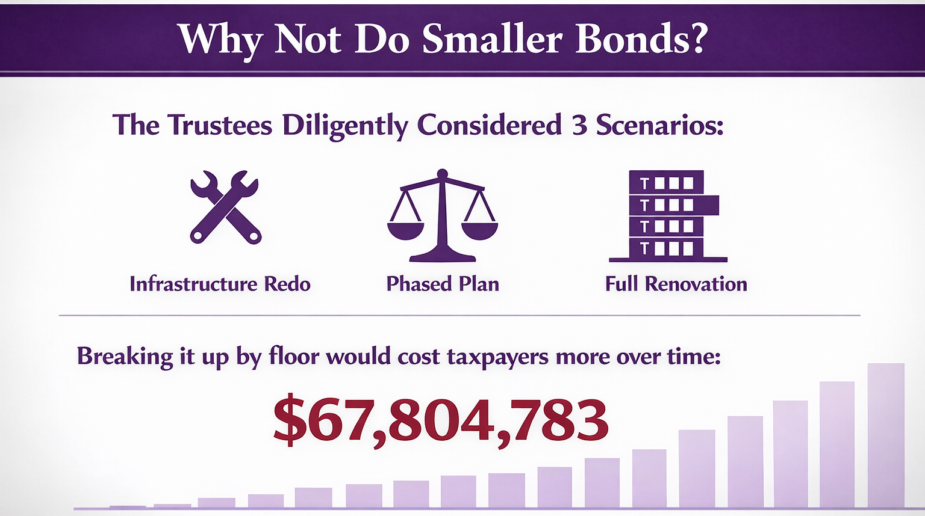

Slide 7

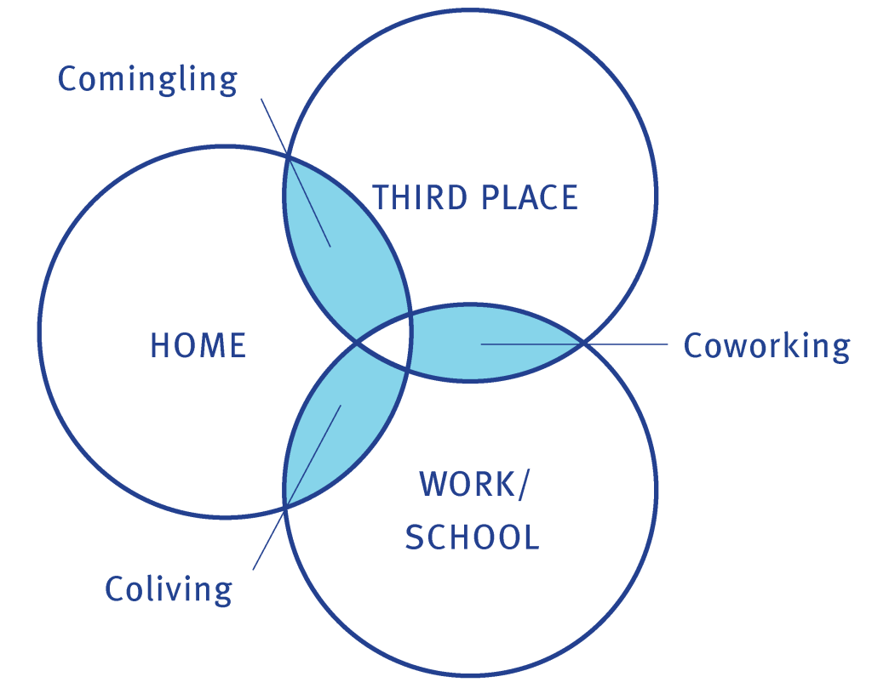
SPACES THAT INSPIRE
A Library Built
for How People
Actually Live
Today's best public libraries aren't just book collections — they're vibrant community anchors where people gather, learn, create, and connect. New Rochelle deserves that kind of library.
Modern public library interior — illustrative

Slide 8
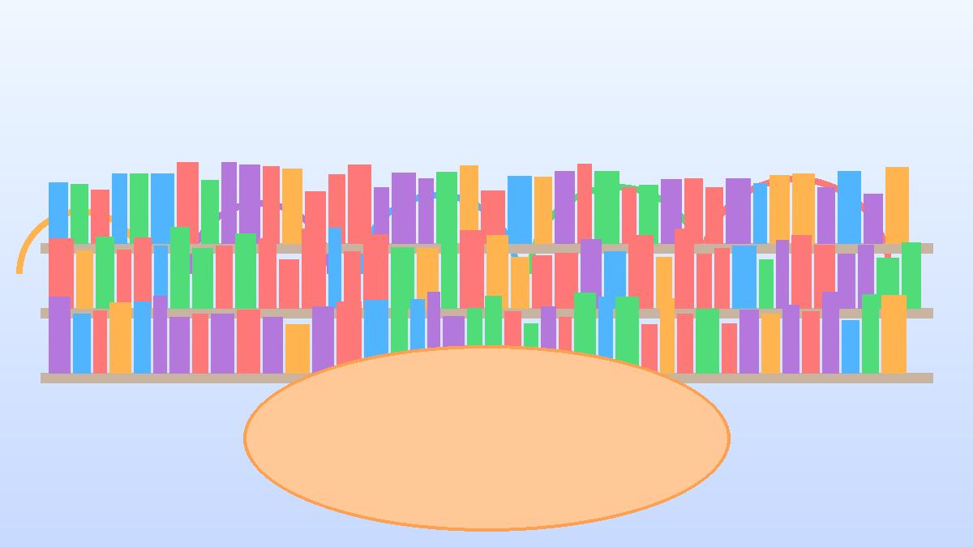
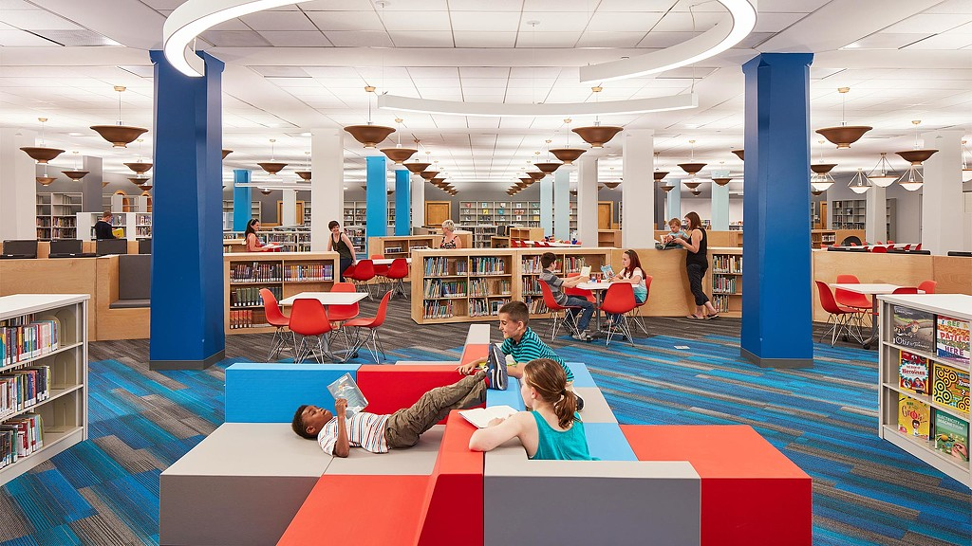
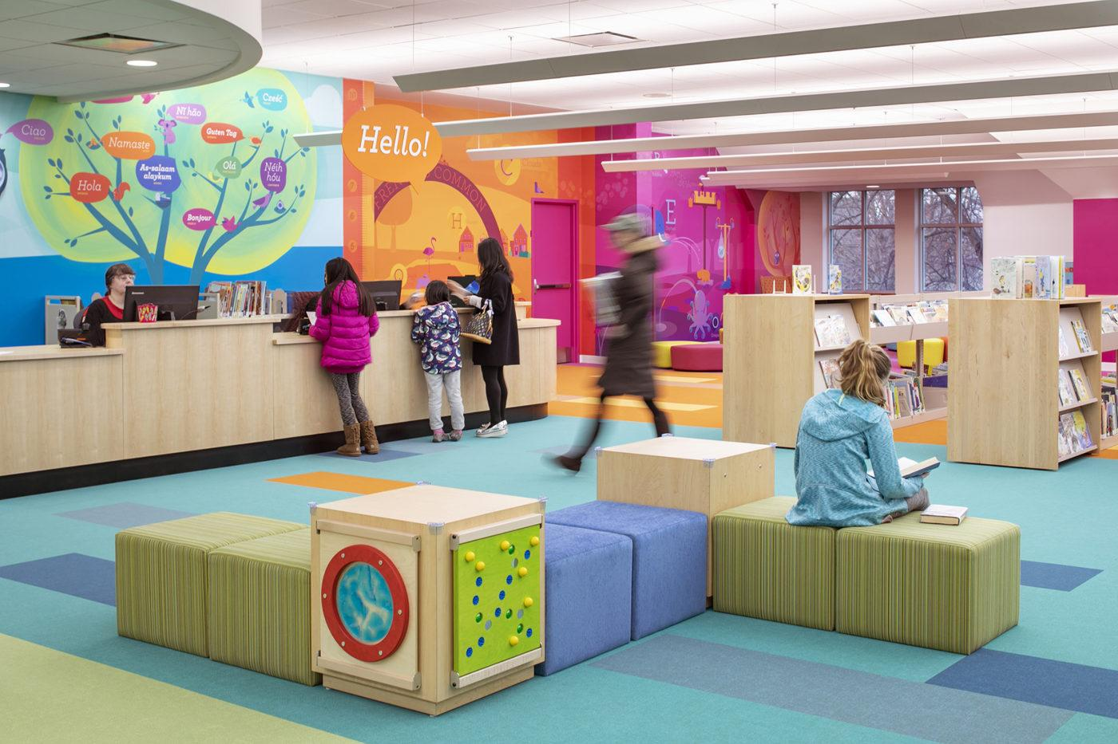
FOR OUR CHILDREN
A Children's Floor
Built to Spark
Curiosity
🌟 Dedicated early literacy zone for ages 0–5
📚 Expanded picture book & chapter book collections
🎨 Hands-on maker & creativity stations
♿ Fully ADA-accessible throughout every level

Slide 9
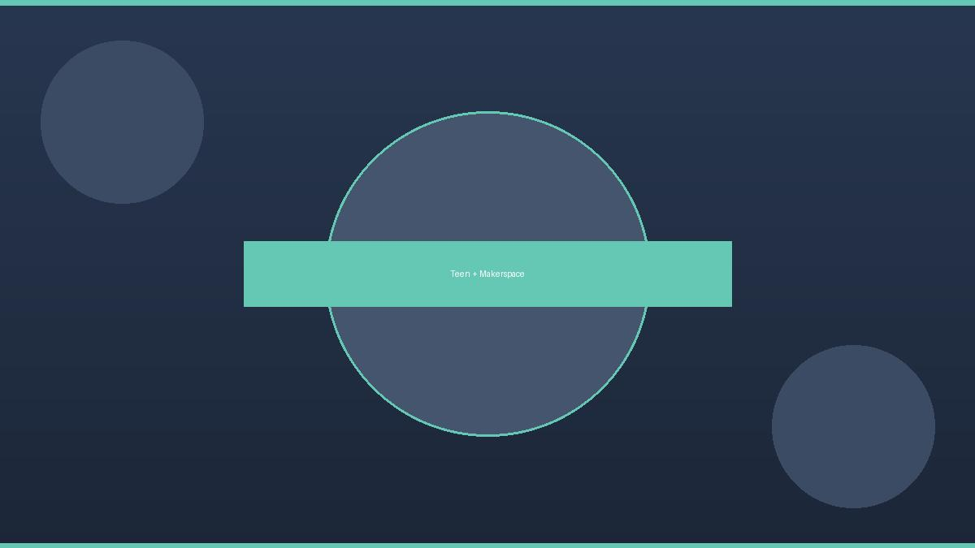
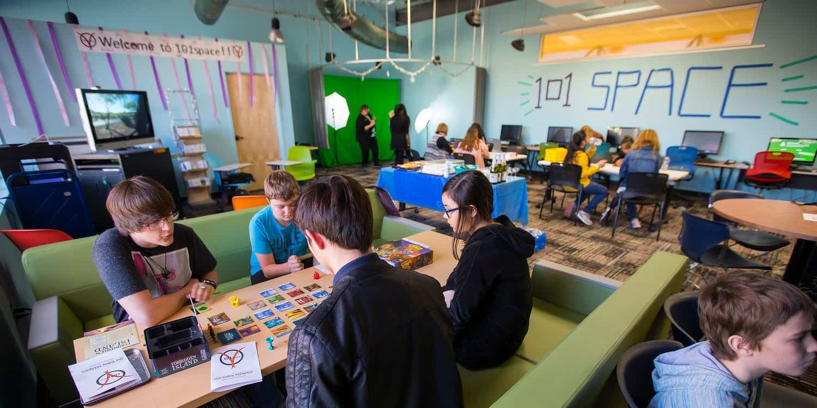
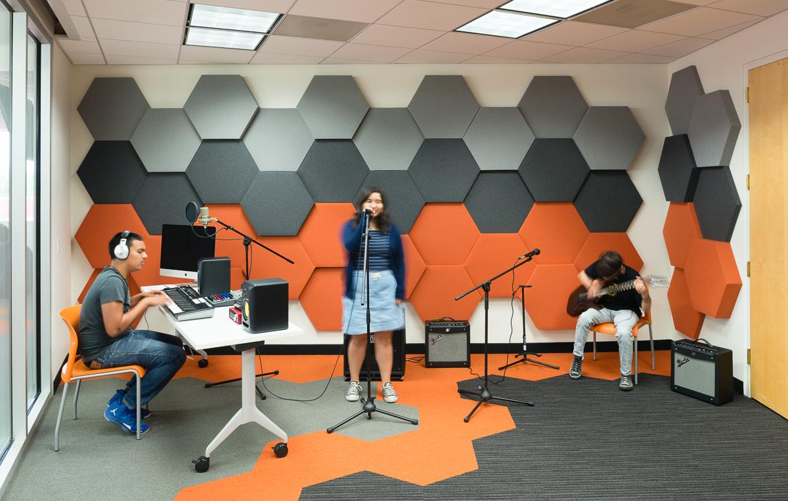
FOR OUR TEENS & YOUNG ADULTS
A Space
That Takes
Teens
Seriously
Makerspace
Study Rooms
Digital Lab
Their Own Zone
3D printing, laser cutting, recording studio
Private booking for homework & projects
Coding, video editing, digital skills
Designed with teen input — not for them, with them

Slide 10
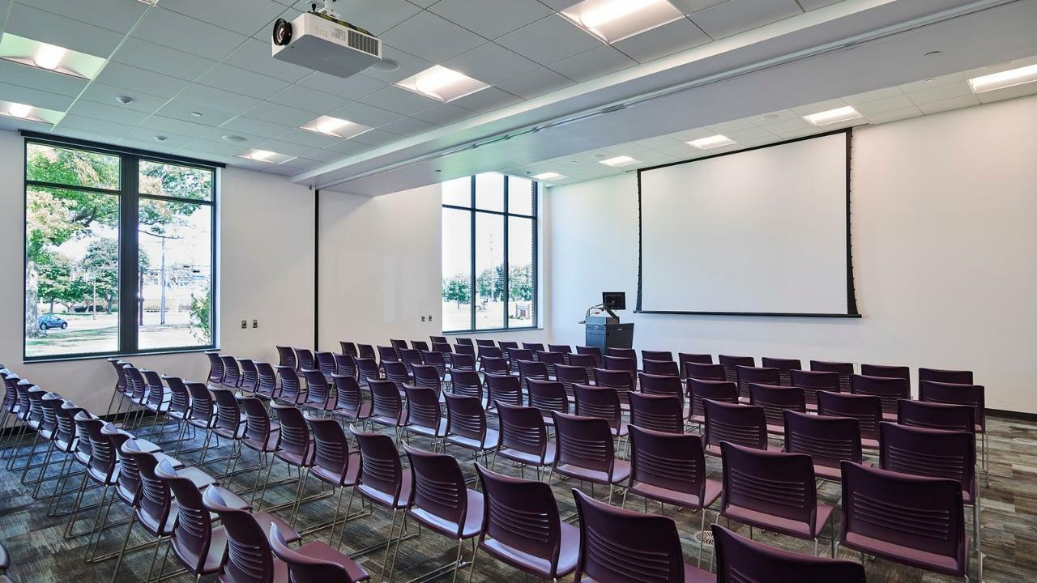
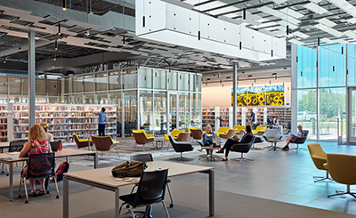
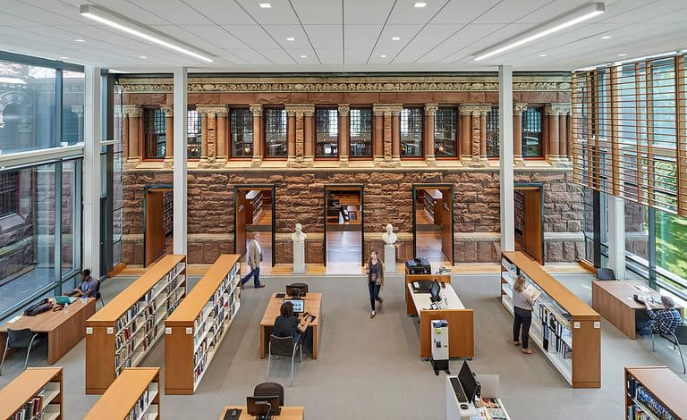
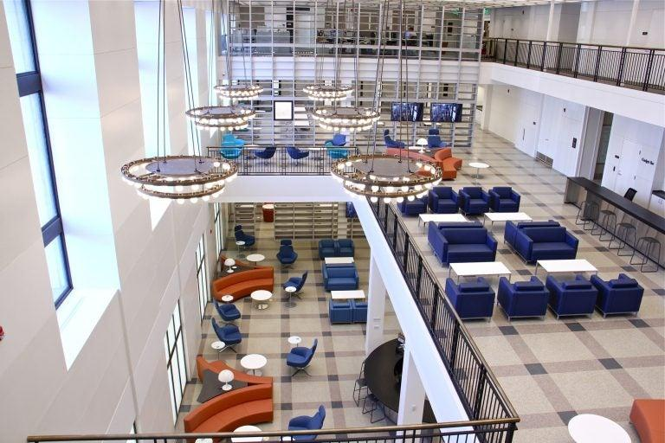
FOR EVERYONE
The Community's
Living Room
The library is New Rochelle's most democratic space — free, open to all, and central to civic life. The renovation transforms it into a place people choose to come, not just a place they pass through.
Flexible programming & event spaces
Quiet study + collaborative work zones
Expanded community meeting rooms
Café-inspired adult reading lounge

Slide 11
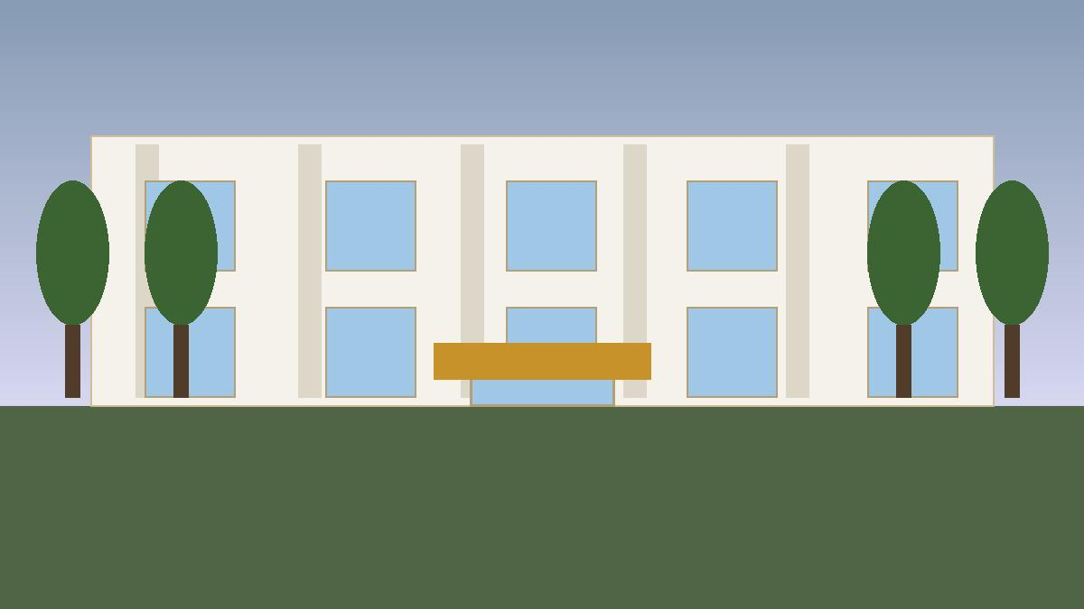
A LANDMARK FOR THE CITY
A Building That Welcomes Everyone
♿ Full ADA Access
🏛️ Community Landmark
🌿 Sustainable Design
Every floor, every space — no exceptions. Ramps, elevators, and accessible restrooms throughout.
Honoring the Award of Excellence for Library Architecture from the American Institute of Architects (AIA) and the American Library Association in 1980 .
Energy-efficient systems, updated HVAC, and a roof that won't leak — built to last 50+ years.

Slide 12
PROJECT COST BREAKDOWN
Category | Amount
General Construction | $20,041,013
Plumbing | $1,086,656
Fire Sprinkler System | $1,003,067
HVAC | $4,597,389
Electrical | $3,510,733
Hard Costs Subtotal | $30,238,858
Project Contingencies | $10,498,689
Soft Costs & Other | $13,858,500
Soft Cost Contingency | $420,563
Category
Amount
$55M
72,330 SF
Proposed Bond Amount
Building Size
Authorized by voters
Total renovation area
$418
$761
Cost per Sq Ft (Hard)
Cost per Sq Ft (Total)
Construction costs only
Full project cost
TOTAL PROJECT COST:
$55,016,610

Slide 13

COST & TAX IMPACT
What does this mean for the average New Rochelle homeowner?
⏱ NO TAX IMPACT UNTIL 2028 AT THE EARLIEST — Bond issuance will not occur before 2028. Taxpayers pay nothing until bonds are issued.
$204
$17
$55M
Per Year
Per Month
Bond Amount
Est. impact once bonds issued
Approx. monthly — after 2028
Voter-approved total
Actual tax impact varies based on individual property assessment. This is a targeted investment in essential public infrastructure spread over time.
Vote: May 19, 2026 | www.nrpl.org

Slide 14


WHY THERE ARE NO FINAL DRAWINGS YET
Final architectural drawings are completed after voter approval. This is standard practice — and it protects taxpayers.
Protects Taxpayer Funds
Follows Legal & Fiscal Process
Avoids spending money on detailed design before the community approves the project.
Ensures the Library follows proper legal and fiscal procedures required for public bonds.
Community Input Shapes Design
Keeps Project Cost-Controlled
Allows residents to inform and influence final design decisions after approval.
Maintains flexibility for value engineering and competitive bidding on final plans.
Voter approval authorizes the Library to complete design and construction responsibly.

Slide 15
WHAT HAPPENS IF THE BOND PASSES
1
Community Engagement
Resident input gathered to confirm priorities and shape the project.
2
Architectural & Engineering Design
Professional teams complete detailed plans and specifications.
3
Final Cost Estimates & Bidding
Competitive bidding ensures value; costs are finalized.
4
Bond Issuance — 2028 at Earliest
Bonds will not be issued before 2028. No taxpayer cost goes into effect until this step.
5
Phased Construction & Public Oversight
Work completed in phases; Library stays open. Regular public updates and board oversight throughout.

Slide 16
2026-2027 PROPOSED BUDGET
 | 2025-2026 (Adjusted) | 2026-2027 Proposed | % Change | Notes
Category | $5,563,200 | $5,737,514 | 3.04% | Includes negotiated salary increases and estimated pension & health costs
Facilities & Equipment | $423,860 | $423,860 | 0.00% | No change
Utilities | $242,724 | $242,724 | 0.00% | No change
Contracted Services | $256,239 | $268,295 | 4.69% | Standard contracted services
Library Materials | $323,316 | $323,316 | 0.00% | Maintains core collection and reflects e-content usage
Tax-Related & Debt Service | $269,029 | $275,000 | 2.22% | Covers SCAR, tax certiorari, and debt service
Future Projects & Capital Funding | $85,000 | $15,000 | 0.00% | Last year included one-time space study funding; base funding remains $15,000
Programming Budget | $143,200 | $143,200 | 0.00% | Last year included one-time additional funding; base funding remains $143,200
Legal/Audit/Insurance | $124,050 | $136,000 | 22.52% | Includes standard funding plus additional audit/legal costs last year
Payroll, Web Tech, Postage & Supplies | $97,050 | $100,421 | 3.47% | System upgrades and operational costs
Total Levy | $7,377,668 | $7,665,330 | 3.75% | Annual Increase for Average Homeowner: $17.04
Questions? Learn more at www.nrpl.org

Slide 17



OVERSIGHT & ACCOUNTABILITY
Your investment is protected by multiple layers of oversight.
Voter-Approved Purposes Only
Board of Trustees Oversight
Bond funds may only be used for the specific purposes authorized by voters on May 19, 2026.
Spending is overseen by the Library Board of Trustees, a publicly accountable governing body.
Public Audit & Reporting
Capped Amount & Tax Impact
All funds are subject to independent public audit and transparent financial reporting.
The bond amount and resulting tax impact are capped at the amount approved by voters.
Questions? Learn more at www.nrpl.org

Slide 18
BUDGET & BOND INFORMATION SESSIONS
Join us to learn more, ask questions, and get involved.
TUESDAY
April 28, 2026
7:00 PM
In Person at the Library • Online
Both sessions will be held in person at the New Rochelle Public Library and online. Visit www.nrpl.org for registration and meeting links.
Questions? Contact us at www.nrpl.org

Slide 19
QUESTIONS
Info Sessions: Thu Apr 16 & Tue Apr 28 | 7 PM | In Person & Online
www.nrpl.org

